Slide 1

Ch. 9 Communicating in Groups Problem Solving in Groups CLO – 04: Identify workplace conflict and develop resolution strategies
EE Communication Skills (SS-2010) Spring 2025
Wk. 10.1.2

Slide 2
Learning Objectives (CLO - 04)
Understand Characteristics of Healthy Groups
Inspect How Groups Develop
Know Group Types
Evaluate Group Dynamics
Problem Solving in Groups (Ch. 8, 10 more details)
Activity # 10 (10 marks) (CLO – 04)

Slide 3
The ability to work in groups is one of the top ten skills sought at undergraduate level
A group is not just an assembly of people, but has specific characteristics
A group is a collection of three or more people who interact and attempt to influence each other to accomplish a common goal
Group Communication includes all the verbal and non-verbal messages shared with or among group members

Slide 4
1. Understand Characteristics of Healthy Groups
Healthy groups are characterized by:
Ethical Goals
Interdependence
Cohesiveness
Productive Norms
Accountability
Synergy

Slide 5
Ethical Goals
Healthy groups have goals that benefit the members and the larger society
Require hard work and sacrifice
Have no illegal or immoral behavior

Slide 6

Interdependent
Members rely on each other’s skills and knowledge to accomplish goals e.g., an orchestra, a sports team

Slide 7
Cohesiveness
The force that brings group members together
Members genuinely cooperate, like and respect each other
They do team building activities
Five factors help build cohesiveness:
When members are attracted to group’s purpose
When membership is voluntary
Members are free to express their honest opinions; even when they disagree
Support, encourage, and provide positive feedback to each other
Members perceive achieving goals and they celebrate accomplishments

Slide 8
Productive Norms
Expectations about the way group members behave while in a group
Healthy norms help members achieve goals/ foster cohesiveness
Norms can be developed through formal discussions/ informal group processes
Explicit rules, specific prescriptive behaviours, can also be formed: e.g.,
Sticking to agenda
Refraining from interrupting
Using brief, only relevant comments
Focusing on issues; not personalities
Expecting everyone to participate
People would struggle to behave differently while belonging to different groups because of different norms for each group

Slide 9
Accountability
All group members are held responsible for adhering to group norms/ goals
Violations of any norms may bring sanctions per severity level
Also means changing counterproductive norms by:
Observing a norm and its outcome
Describing the results of a norm to group members
Endorsing opinions of other group members

Slide 10
Synergy
It is the multiplying energy of a combined intelligence in a group
A combined effort is valued more than individual parts; e.g.,
Many sports record books are filled with ‘no-name teams’
Unknown soldiers/ martyrs of a battle

Slide 11
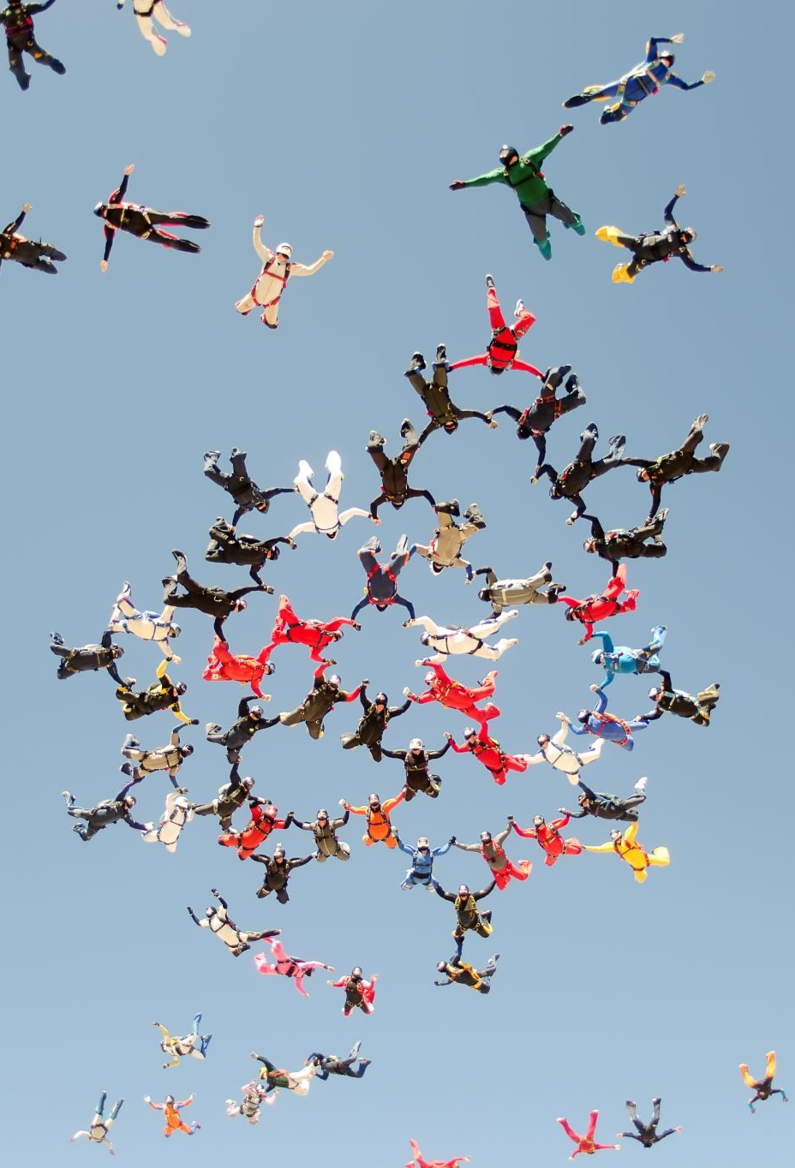
2. Inspect How Groups Develop – Bruce Tuckman’s Model (1965)
Just as interpersonal relations go through identifiable life cycles, so do groups undergo stages of development:
Forming
Storming
Norming
Performing
Adjourning

Slide 12
How Groups Develop (Cont’d) – 1. FORMING
The Initial Stage:
Orientation/ introduction
Testing/ talents/ skills/ abilities
Dependence on members’ skills
Goal setting/ understanding
Member-roles understanding
Interactions are polite/ positive/ friendly
Disagreements are refrained
Calculated self-disclosure

Slide 13
How Groups Develop (Cont’d) – 2. STORMING
The Second Stage:
The goal is understood/ members are comfortable
Members express opinions to have settled a place in the group
Power and position is sought
Constructive disagreements
Politeness gives way to aggressiveness, sarcasm
Side-taking
Coalition formation
Severe storming may break a group
‘No Storming’ may cause ‘groupthink’ – a deterioration of mental efficiency, reality testing, moral judgment

Slide 14
How Groups Develop (Cont’d) – 3. NORMING
The Third Stage:
Increased cohesion/ collaboration
Increased trust among members
Motivation to achieve the common goal(s)
Major differences resolve
Expression of honest opinion
Appreciation/ acceptance of differences
Stronger relationships
Norms get accepted
Positive feedback

Slide 15
How Groups Develop (Cont’d) – 4. PERFORMING
The Fourth Stage:
Harmony
Shared leadership
Productivity
Problem-solving
Collective use of skills/ abilities/ knowledge
Task-focused conversations
Full potentials utilized
Conflicts stay minimum

Slide 16
How Groups Develop (Cont’d) – 5. ADJOURNING
The Fifth Stage:
Formal/ informal celebration of goal achievement
Recognition of member roles
Feedback/ evaluation
Members start disengaging (a few may see each other in other social settings)
The developed norms may continue

Slide 17
3. Know Group Types
Member expectations/ norms vary from group to group and on their goals
Groups are categorized according to their purpose
The most common types are:
Families
Social Friendship Groups
Support Groups
Interest Groups
Service Groups
Work Groups

Slide 18
Group Types (Cont’d) – 1. Families
Intimates having a sense of home and group identity
Strong ties of loyalty and emotions
Experience history and future
Have agreed upon norms
Families can be:
Nuclear (two parents living together with children)
Single parent (one adult living with his/ her children)
Extended (parent/s and children living with grandparents, close relatives, cousins, aunts)
Blended (married adults living with the children of their previous marriages)
Mixed (married adults of different races)

Slide 19
Group Types (Cont’d) – 1. Families – how do they function
Families function in four different ways when facing an issue:
In protective families, issues are not discussed. Only the family authority decides
In consensual families, all members engage in conversation, but the final decision is made by the family authority figure
In pluralistic families, all members engage in conversation, and everyone participates in decision-making. Formal family meetings are conducted.
In laissez-faire families, members may converse about an issue, but each member makes his/ her own decision and is responsible for its consequences
Healthy families should talk in ways that build one another’s self-respect, self-concept, and self-esteem by:
Praising each other
Offering statements of acceptance and support
Verbally expressing love and cohesion

Slide 20
Group Types (Cont’d) – 2. Social Friendship Groups
Comprise friends having genuine concern about each other’s welfare
Enjoy spending time together
Have strong inter-personal ties
Foster pre-existing, amiable relationships
Have shared interests
Fill mutual needs of acceptance and sense of belonging
Offer mutual protection

Slide 21
Group Types (Cont’d) – 3. Support Groups
Comprise people who come together by providing:
Encouragement/ comforting statements
Honest feedback
A safe environment – members trust and share most personal information/ experiences/ traumas
Members deeply express feelings about a problem experienced/ common to all
There are thousands of on-line and face-to-face support groups
Mutual communication/ self-information is well protected

Slide 22
Group Types (Cont’d) – 4. Interest Groups
Have a shared/ common interest/ hobby/ concern/ activity/ passion
Often formal with defined goals/ tasks
May be a part of a larger organization and may have local chapters
Focus on enhancing skills/ knowledge of group members
Share success stories
Plan future activities/ sustain growth

Slide 23
Group Types (Cont’d) – 5. Service Groups
Individuals who come together to perform specific tasks – charity collection, humanitarian relief works, social services during crises, small business support, …
Since these groups are both voluntary and task-oriented, they should consider:
Members’ ego/ self-esteem
Emotional needs
Roles
Responsibilities
Encourage/ appreciate accomplishments
Politeness
Ethical norms

Slide 24
Group Types (Cont’d) – 6. Work Groups
A collection of three or more people formed to solve a problem/ accomplish a specific task – class project groups, joint presentations, perform specific activities at workplace, …
Have clearly defined goals
Have appropriate number of members
Have diversity in skills and viewpoints but relevant to specific goals
Well-motivated
Smaller groups make decisions faster than larger groups
Larger groups experience more complex issues
Heterogeneous groups are better than homogenous groups
Collaborative to resolve issues/ conflicts
Update other members on individual member contributions/ efforts
Appropriately credit the other members’ contributions/ achievements

Slide 25
4. Evaluate Group Dynamics
Group dynamics is the way a group interacts to achieve its goal(s)
Effective groups periodically stop and evaluate how their interactions are affecting what they are accomplishing and how their members perceive themselves and others
At workplace, you may be asked to provide a formal evaluation of the group dynamics/ members to the higher authorities
The areas could be:
Performance (individual members/ group…)
Communication
Cohesiveness
Problem solving
Conflict management
Ethics
Reflective thinking
Areas to improve…

Slide 26
References
1. Bovee & Thill. (2016) Business Communication Today 13th Ed. (Prentice-Hall)
2. Kathleen S. Verderber. Communicate (13th Ed.)

